Slide 1
Section 14.2 Chi-Square Test for Homogeneity and Two Way Tables

Slide 2
Chi Square test for Homogeneity and Association
Chi-Square Test for Homogeneity is a statistical test for determining whether the distribution of frequencies for a categorical variable is the same across different populations or groups
Ie: suppose we want to compare the political distribution of BC, Alberta, and Ontario by looking at the percentage of the population that voted for each party: BC: Liberals 27% Conservatives 33.2% NDP 29.2% Other 10.6% Alberta: Liberals 15.5% Conservatives 55.3% NDP 19.1% Other 10.4% Ontario: Liberals 39.3% Conservatives 34.9% NDP 17.8% Other
A Chi-Square test for Homogeneity would compare the proportions of political party votes of each province and then test if there is homogeneity between these provinces
The purpose of the chi-square test for association is to determine whether there is a statistically significant association between two categorical variables
When we have a TWO way table with TWO variables, the test of association will determine whether there is a statistically significant association between two categorical variables

Slide 3
Chi Square test for Homogeneity:
Determine if there is homogeneity in the distribution of a categorical variable for multiple populations
Hypothesis:
Ho: The proportion of the population that voted political party is the same amongst the province of BC, Alberta, and Ontario
Ha: There is a significant difference in the proportions of political party votes between BC, Alberta, and Ontario
Conditions: Same as the test for Goodness of Fit
SRS, All Expected Counts > 5, Independence [the populations are independent],
The number of rows/columns refers to the matrix that you create for your chi-square test
Conclusion: If you do reject the Null Hypothesis, make sure to indicate which Observed value differed most from the Expected value

Slide 4
General Procedure for calculating Chi Square:
Suppose this is your chart with all the data and we want to perform a chi-square test to indicate a significant relationship between group number of colour:
The letters in these boxes are the observed values. O₁, O₂,…..O_{n}
Your next objective is to find all the expected values
Get the total of each row & column
The total number of data is “n”
To find the Expected value of each cell, multiply the “Row Total” w/ “Column Total”, then divide by “n”
To calculate for chi square, square the difference between each observation and expected value, divide it by the expected value. Then take the sum
To find the Pvalue, you need the Degrees of freedom:
Df=(No. of Colours – 1) x (No. of Groups -1)

Slide 5
Ex: A SRS of 126 students were asked whether if they preferred a “high” contact sport, “med” contact sport, or a “low” contact sport. The results are in the table below. Do these data provide convincing evidence that the preference in contact level in sports differ between the male and female?
a) State your hypothesis to do a Chi-Sq test for homogeneity
b) Calculate the totals and the expected value for each cell
c) State the conditions to perform a chi-square test?
d) Calculate the chi-square, df, and P-value from your statistics
e) State and Interpret your conclusion.

Slide 6
a) State the Null and Alt. Hypothesis
Ho: The distribution of sports preferred based on contact level is the same between genders
Ha: The distribution of sports preferred based on contact level is not the same between genders
NOTE: “Ha” will always say the proportion/distribution is NOT the same. Never greater or less than like in CH11 or 12
b) Calculate the totals and the expected value for each cell
Observed Count
Expected Count
c) State the Conditions for performing a Chi-Square Test for Homogeneity:
To use the Chi-square test for homogeneity of population:
SRS → It is indicated that the sample was taken from a SRS
Normality: All expected cell counts greater than 5
Independence: The populations between each gender are independent from each other

Slide 7
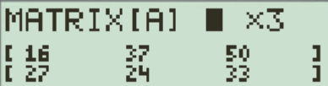
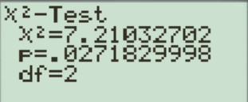
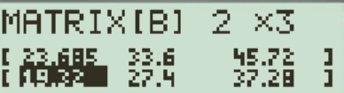
d) Step 3: Calculate the test statistic Chi square
Use the calculator to do this!!
Observed:
Expected:
With a P-value less than a significance level of 5%, we have evidence to reject the Null hypothesis and accept the Alternative hypothesis that males and females prefer different levels of contact sports
The value that contributed most to our chi square value is male preference for high contact sports

Slide 8
Chi Square Test for Association/Independence:
Difference Between a Chi Square test for Homogeneity and the chi square test for Association/Independence:
HOMOGENEITY Association/Independence
Multiple populations
Comparing Two categorical variables from one population
Only one categorical variable
Compares if there is homogeneity of the distribution between the different populations of the one variable
Examines the association between TWO categorical variables, no need to indicate which one is dependent or independent!!
Hypothesis:
Ho: There is no difference in the distribution of the categorical variable between the population
Ha: There is a difference in the distribution of the categorical variable between the population
Hypothesis:
Ho: There is No association between the two categorical variables within a set population
Ha: There is an association between the two categorical variables within a set population

Slide 9
Indicate how a test for Homogeneity vs Association would look like for each scenario:
Ex: A teacher wants to know how students feel about the new quarter system. He commissions a poll to examine the opinions of grade 8’s, 9’s, 10’s, 11’s and 12’s regarding keeping the new quarter system. Which test should he employ?
Ex: A counsellor wants to study the distribution of family sizes. She wants to see if family demographics and sizes differ between students from different schools in Alpha, Moscrop, and B. South. Which test should she employ?
Ex: Students are studying the grade distribution between three teachers:

Slide 10
Ex: A teacher wants to know how students feel about the new quarter system. He commissions a poll to examine the opinions of grade 8’s, 9’s, 10’s, 11’s and 12’s regarding keeping the new quarter system. Which test should he employ?
If we want to investigate whether if each grade feels the same with the new quarter system, then we would perform a test for homogeneity
If we want to test for an association between grade level and feelings about the new quarter system, then we can do a test for association.
Ex: A counsellor wants to study the distribution of family sizes. She wants to see if family demographics and sizes differ between students from different schools in Alpha, Moscrop, and B. South. Which test should she employ?
A ChiSq test for homogeneity would compare the distribution family demographic sizes between the three schools.
A ChiSq test for association would look for a relationship between the school a student attends and the size of their family. Ie: Students from a certain school would have bigger or smaller family size
Ex: Students are studying the grade distribution between three teachers:
ChiSq test for homogeneity would test to determine if the grade distribution is homogeneous between the three different teachers
Test for Association would look for a relationship between grade levels and the teacher students have

Slide 11
Chi Square Test for Association/Independence:
Purpose: determine if there is a relationship between two categorical variables
Conditions:
Independence: observations are independent within and between groups
Sample Size: the expected count for each cell in the matrix is at least 5
All expected counts are greater than 1 and there are none less than 5
Df = (row – 1 ) (column – 1)
Ex: A doctor wants to examine the effect of Aspirin and Tylenol on patients with different types of diabetes
a) What are the categorical variable(s)?
b) What is the population?
c) Write the Null and Alternative Hypothesis
a) Categorical Variables: Type of drugs and the type of diabetes
b) Patients with diabetes
c) Ho: There is NO association/effect between type of drug and type of diabetes on diabetic patients:
Ha: There is an association/effect between type of drug and type of diabetes on diabetic patients:

Slide 12
For each scenario: a) Indicate the categorical variable(s) and the population involved
b) Write the Null and Alternative Hypothesis
Ex: The owner of a local restaurant we want to examine if playing a certain type of music would encourage ppl to purchase a particular wine. Is there an association between music played in a restaurant and type of wine ordered. Data is provided below:
Ex: Has student graduate plans in Moscrop changed over time? Over the last four decades, a SRS of 384 students were studied on which path they chose after HS. Data is provided below:

Slide 13
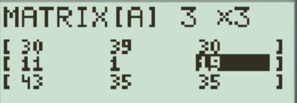
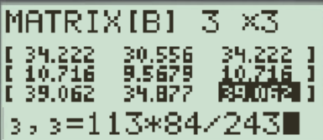
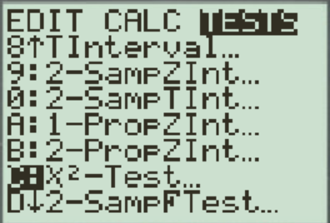
Using Ti-83 To find Chi Square and P-value
Ex: Does playing certain music increase certain wine sales? Perform a chi-square test of association to determine if there is significant evidence in relationship between Wine sales and music type:
Calculating for Chi-square by hand can be very time consuming
To make things easier, we will use the Matrix function on your Ti-83
Go to “Matrix”: 2nd , X⁻¹
Then go to “EDIT”, press enter
Change size to “3” x “3” and enter observed data
Do the same thing again in Matrix “B” for the Expected Data
When all data is entered, go to “STAT”, “TEST”, “C: Chi-Sq Test”, Press Enter
This is matrix “A: These are the Observed data:
This is matrix “B”: These are the Expected data:

Slide 14
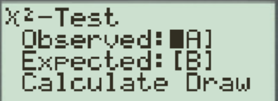
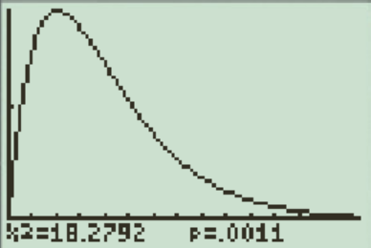
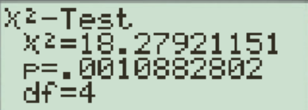
All the data is entered in Matrix “A” (Observed) and Matrix “B” (Expected)
The next thing to do is to perform a chi-square test
You can see that the chi-square value is 18.279, DF = 4, and P-value is very small at 0.0011
Remember: Use your Ti-83 to find the Chi-square value from now ON!!
NOTE: Expected counts do not need to be WHOLE numbers
Since our P value is so low, this indicates that we should reject the NULL hypothesis and accept the Alternative Hypothesis where there is an association between the type of music played and the type of wine that is sold.

Slide 15
Q: For the Wine Sales example, which of the following is the correct Null and Alternative Hypothesis:
Population 1: Bottles of wine sold when no music is played
Population 2: Bottles of wine sold when French music is played
Population 3: Bottles of wine sold when Italian music is played
a) Ho: The number of wine sold are the same in all three populations
Ha: The number of each wine sold are different in all three populations
b) Ho: The proportion of wine sold are the same in all three populations
Ha: The proportion of each wine sold are different in all three populations
c) Ho: The proportion of wine sold are the same in all three populations
Ha: The proportion of each wine sold are different and is greater when music is played

Slide 16
Q: A study wanted to examine the association of living accommodations between male and female young adults in BC. Researchers asked SRS of young adults on whether if they were living with their parents, friend’s place, own place, or room mate. The table below displays the results omitting a few non-responses and “homeless” answers.
A) Is this a test of Homogeneity or Association? What are the categorical variable(s) and population(s)?
B) State the Null and Alternative Hypothesis in context
C) State and verify all the conditions required to perform a chi square test
D) Calculate the Chi-Square value and P value
E) State your conclusion in context

Slide 17
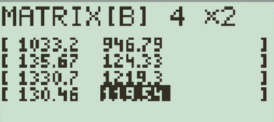
a) The population of interest are young adults from 18 to 30 years old
b) Ho: There is no association between where young adults live and gender
HA: There is an association between where young adults live and their gender
c) To perform a chi-square test for homogeneity of population the conditions are:
i) The data must be independent SRS from the population of interest. This is verified as stated in the question
ii) All expected counts are greater than 5 and no more than 20% are less than 5.

Slide 18
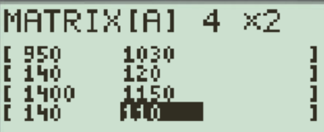
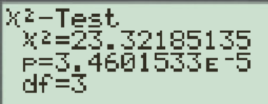
d) Calculate the test statistics Chi-square:
P-value = 0.00003460 < 0.00005
With such a low P-value conclude that the choices of living places are different for males and females.
More specifically, females are less likely to live with their parents and more likely to have a place on their own.

Slide 19
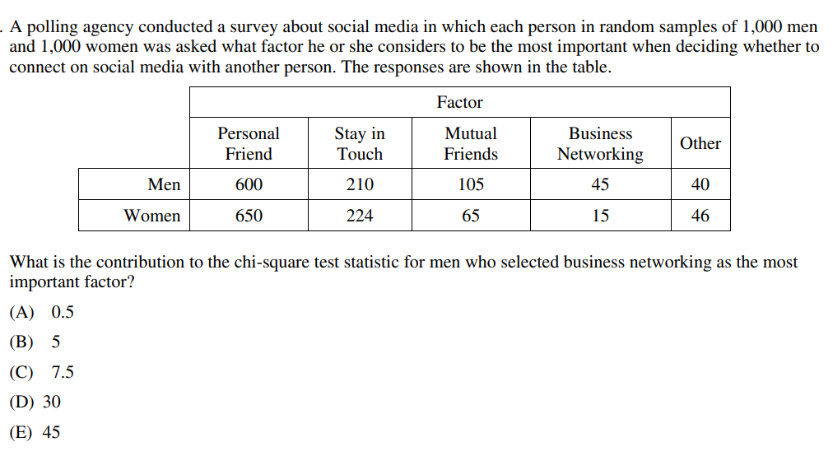

Slide 20
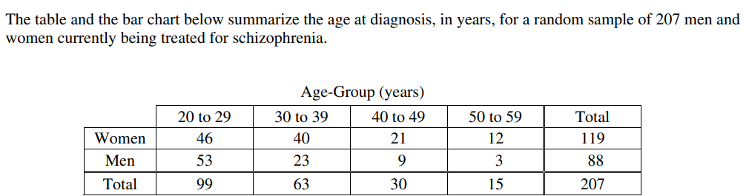
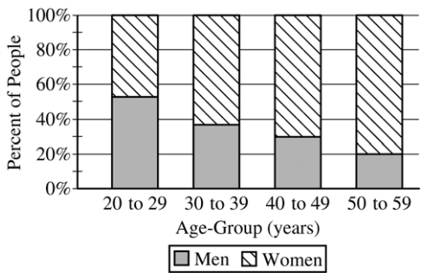

Slide 21
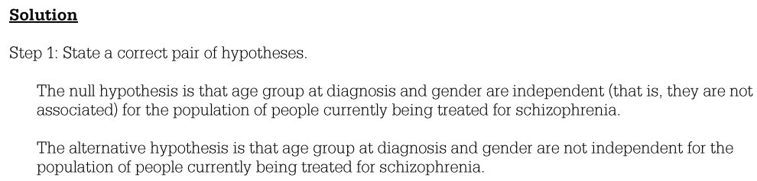
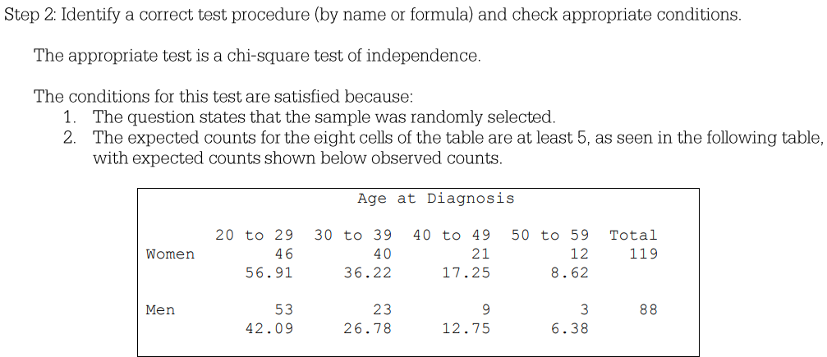

Slide 22
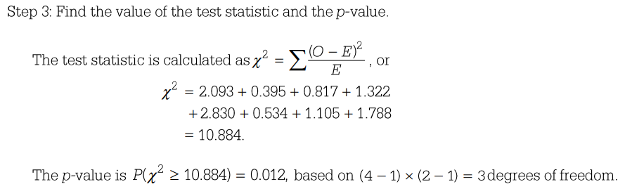
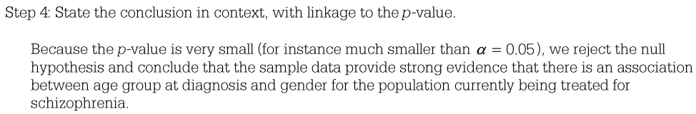
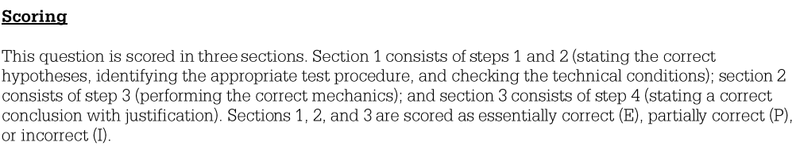

Slide 23
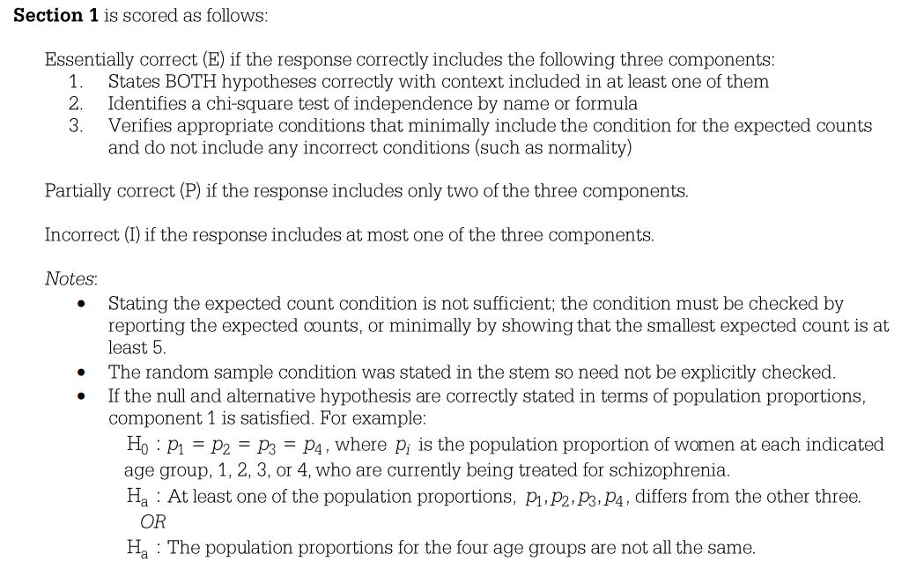

Slide 24
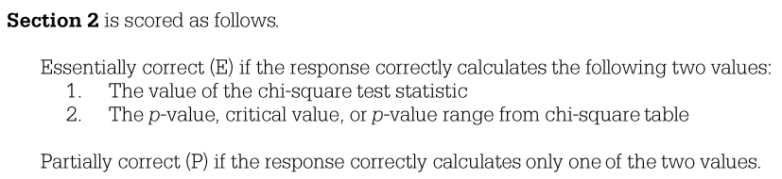
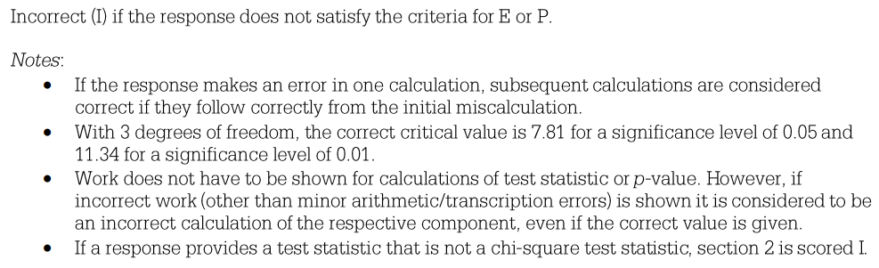

Slide 25
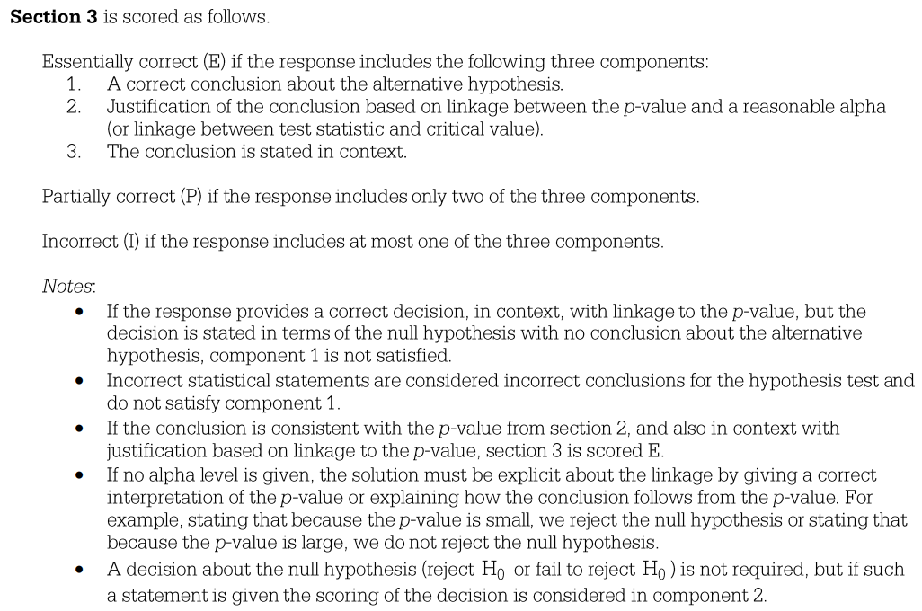

Slide 26
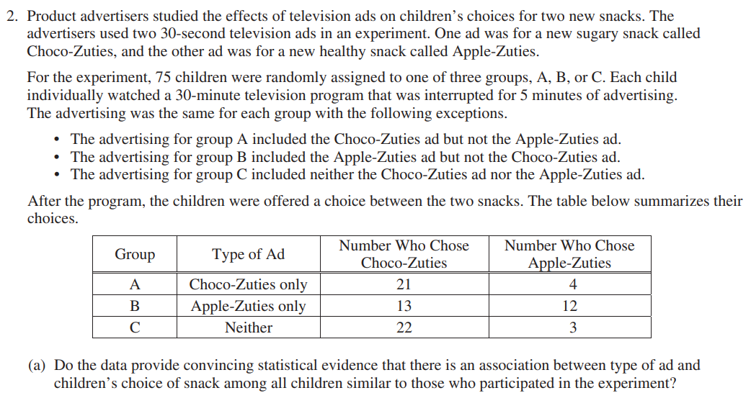

Slide 27
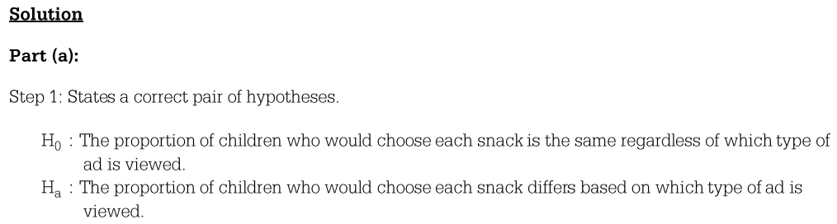
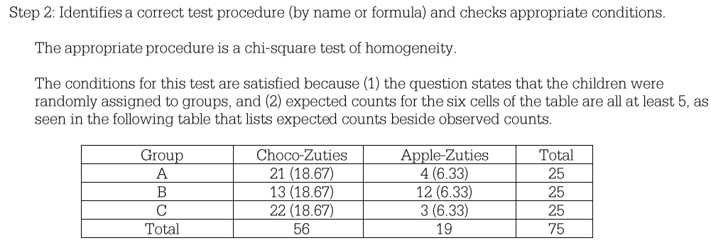

Slide 28
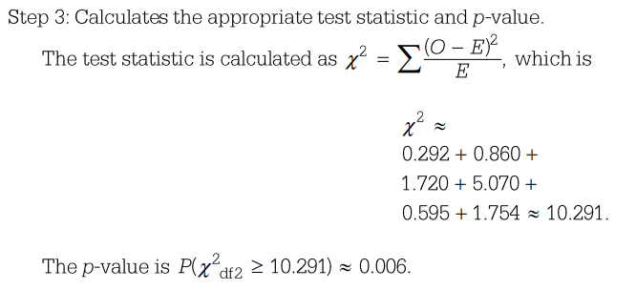
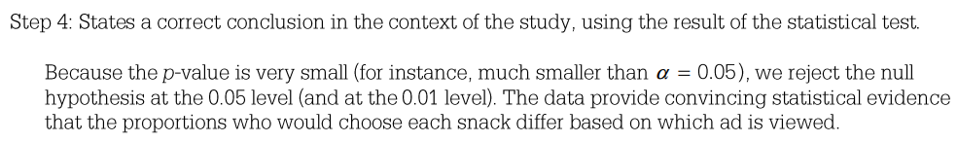

Slide 29
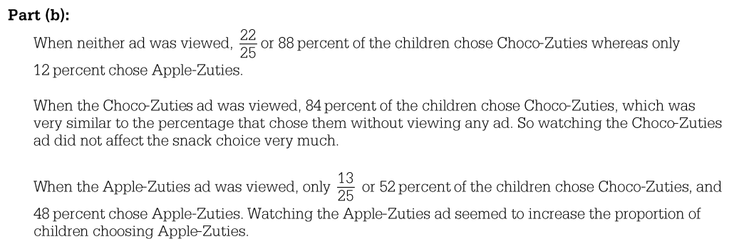
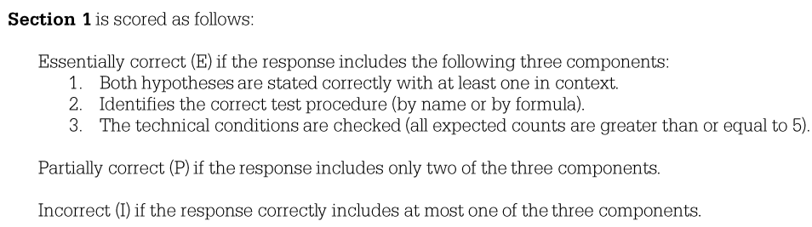

Slide 30
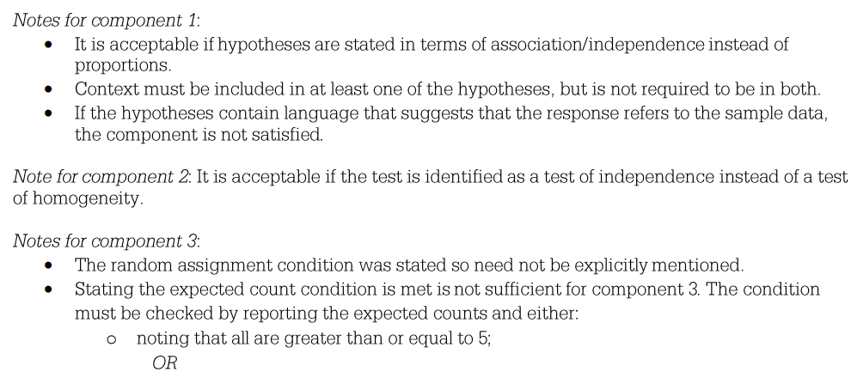
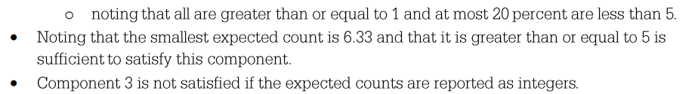

Slide 31
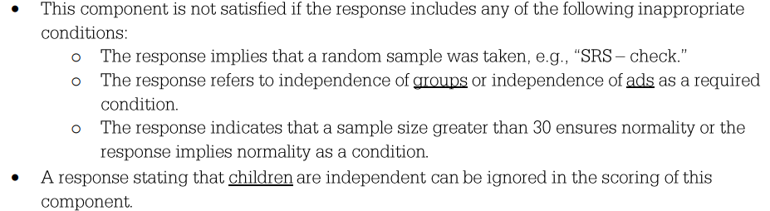
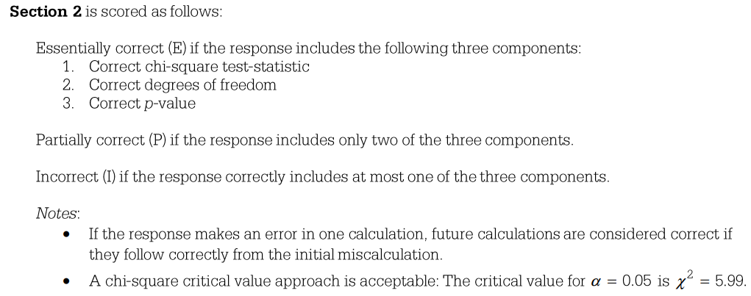

Slide 32
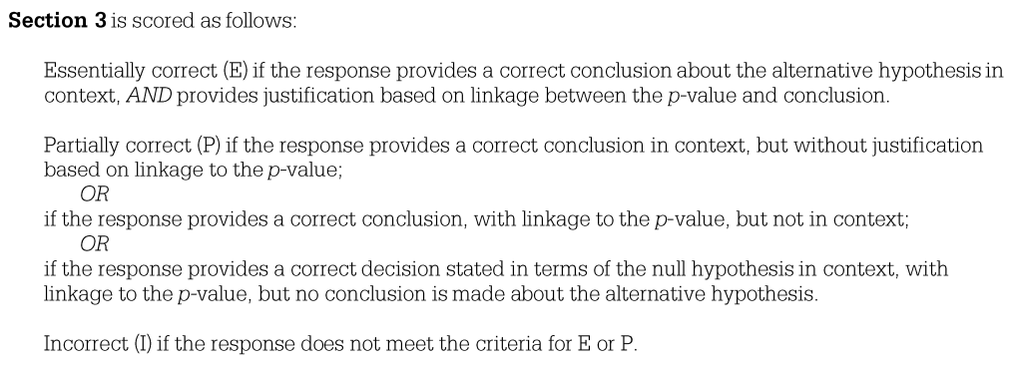
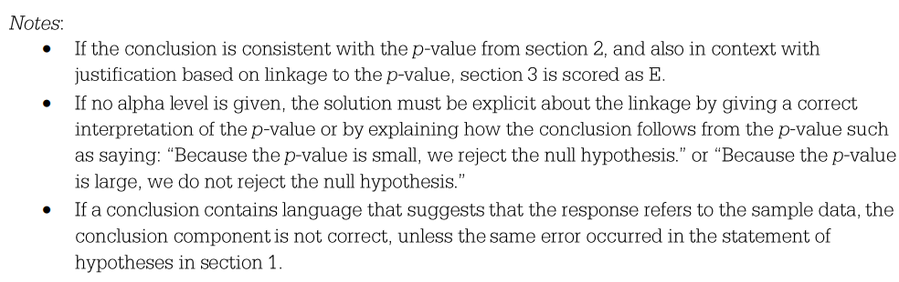

Slide 33
